Slide 1
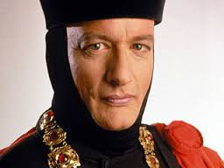
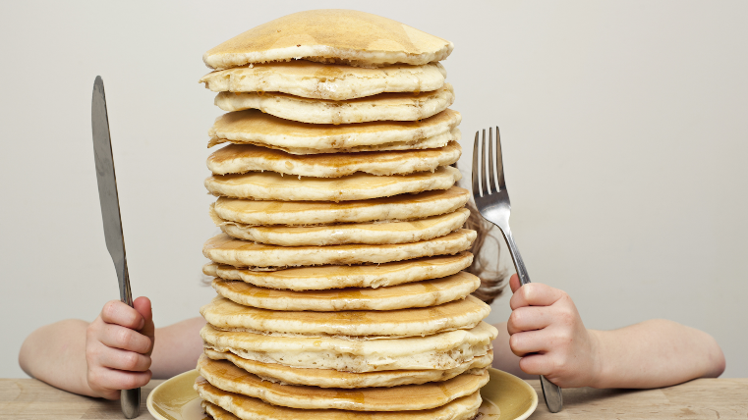




Stacks and Queues
CLRS, Section 10.1

Slide 2
Abstract Data Types (ADTs)
Abstract Data Type (ADT): A specification of a collection of data and the operations that can be performed on it.
Describes what a collection does, not how it does it
Consumers of a stack or queue do not need to know how they are implemented.
We just need to understand the idea of the collection and what operations it can perform.
Stacks usually implemented with arrays.
Queues often implemented with a linked list, but can use a circular array.

Slide 3
Stacks and Queues
Some data structures are constrained so consumers only use optimized operations.
stack: retrieves elements in reverse order as added.
queue: retrieves elements in same order as added.
push
pop, peek
top | 3
 | 2
bottom | 1
front |  | back
1 | 2 | 3
dequeue, first
enqueue
queue
stack

Slide 4

Stacks
Stack: A collection based on the principle of adding elements and retrieving them in the opposite order.
Last-In, First-Out ("LIFO")
Elements are stored in order of insertion.
We do not think of them as having indexes.
Consumer can only add/remove/examine the last element added (the "top").
basic stack operations:
push: Add an element to the top.
pop: Remove the top element.
peek: Examine the top element.
push
pop, peek
top | 3
 | 2
bottom | 1
stack
Notes:
analogy: trays of food at the sizzler

Slide 5
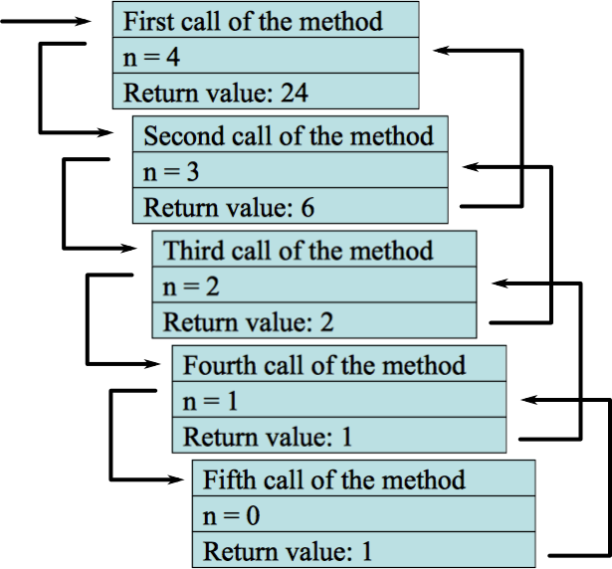
Stacks in Computer Science
Programming languages and compilers:
Method calls are placed onto a stack.
call=push
return=pop
Compilers use stacks to evaluate expressions.
Matching up related pairs of things:
Find out whether a string is a palindrome.
Examine a file to see if its braces { } match.
Convert "infix" expressions to pre/postfix.
Sophisticated algorithms:
Searching through a maze with "backtracking."
Many programs use an "undo stack" of previous operations.

Slide 6
Stacks and Queues Operations
Stack
Last-in, first-out (LIFO)
Queue
First-in, first-out (FIFO)
Operations:
push (insert)
pop (delete)
Implementation:
Array S of size n.
Attribute S.top pointing to the index of the most recently inserted element.
Operations:
enqueue (insert)
dequeue (delete)

Slide 7
Stack Example
Empty stack S
S.top
S:
1 | 2 | 3 | 4 | 5

Slide 8
Stack Example
Empty stack S
push(4)
S.top
S:
1 | 2 | 3 | 4 | 5
4

Slide 9
Stack Example
Empty stack S
push(4)
push(1)
S.top
S:
1 | 2 | 3 | 4 | 5
4 | 1

Slide 10
Stack Example
Empty stack S
push(4)
push(1)
push(3)
S.top
S:
1 | 2 | 3 | 4 | 5
4 | 1 | 3

Slide 11
Stack Example
Empty stack S
push(4)
push(1)
push(3)
pop()
S.top
S:
1 | 2 | 3 | 4 | 5
4 | 1

Slide 12
Stack Example
Empty stack S
push(4)
push(1)
push(3)
pop()
push(8)
S.top
S:
1 | 2 | 3 | 4 | 5
4 | 1 | 8

Slide 13
Stack Example
Empty stack S
push(4)
push(1)
push(3)
pop()
push(8)
pop()
S.top
S:
1 | 2 | 3 | 4 | 5
4 | 1

Slide 14
Stack Implementation
When S.top = 0, the stack is empty.
If we do pop on an empty stack, we have an underflow exception.
If S.top > n, we have an overflow exception.

Slide 15
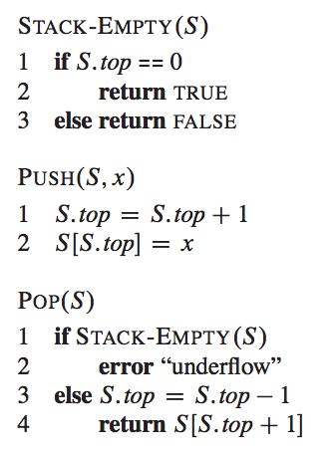
Stack Implementation
Each of the three operations takes O(1) time.

Slide 16
Stack Limitations
You cannot loop over a stack in the usual way. Assume we created our own Stack class.
Stack<Integer> s = new Stack<Integer>();
...
for (int i = 0; i < s.size(); i++) {
do something with s.get(i);
}
Instead, pop each element until the stack is empty.
// process (and destroy) an entire stack
while (!s.isEmpty()) {
do something with s.pop();
}

Slide 17
What Happened to My Stack?
Suppose we're asked to write a method max that accepts a Stack of Integers and returns the largest Integer in the stack:
// Precondition: !s.isEmpty()
public static void max(Stack<Integer> s) {
int maxValue = s.pop();
while (!s.isEmpty()) {
int next = s.pop();
maxValue = Math.max(maxValue, next);
}
return maxValue;
}
The algorithm is correct, but what is wrong with the code?

Slide 18
What Happened to My Stack?
The code destroys the stack in figuring out its answer.
To fix this, you must save and restore the stack's contents:
public static void max(Stack<Integer> s) {
Stack<Integer> backup = new Stack<Integer>();
int maxValue = s.pop();
backup.push(maxValue);
while (!s.isEmpty()) {
int next = s.pop();
backup.push(next);
maxValue = Math.max(maxValue, next);
}
while (!backup.isEmpty()) { // restore
s.push(backup.pop());
}
return maxValue;
}

Slide 19

Queues
Queue: Retrieves elements in the order they were added.
First-In, First-Out ("FIFO")
Elements are stored in order of insertion but don't have indexes.
Client can only add to the end of the queue, and can only examine/remove the front of the queue.
Basic queue operations:
enqueue (add): Add an element to the back.
dequeue (remove): Remove the front element.
first: Examine the front element.
front |  | back
1 | 2 | 3
dequeue, first
enqueue
queue
Notes:
analogy: trays of food at the sizzler

Slide 20
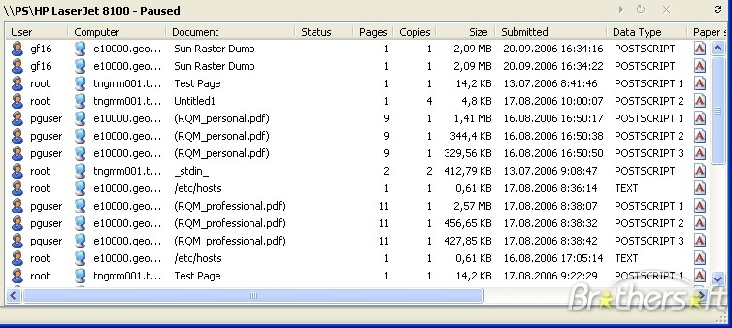
Queues in Computer Science
Operating systems:
Queue of print jobs to send to the printer.
Queue of programs / processes to be run.
Queue of network data packets to send.
Programming:
Modeling a line of customers or clients.
Storing a queue of computations to be performed in order.
Real world examples:
People on an escalator or waiting in a line.
Cars at a gas station (or on an assembly line).

Slide 21
Stacks and Queues
Stack
Last-in, first-out (LIFO)
Queue
First-in, first-out (FIFO)
Operations:
PUSH (insert)
POP (delete)
Implementation:
Array S of size n
Attribute S.top pointing to the index of the most recently inserted element
Operations:
ENQUEUE (insert)
DEQUEUE (delete)
Implementation:
Array Q of size n
Attributes Q.head and Q.tail

Slide 22
Queue Implementation
The array Q is considered as a circular array.
Q.head points to the index in which the earliest inserted element resides.
Q.tail points to the index in which a new element should be inserted.
Initially, we have Q.head = Q.tail = 1.

Slide 23
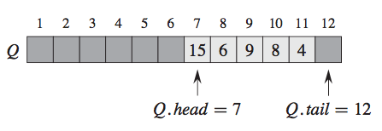
Queue Example

Slide 24
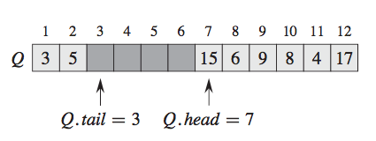
Queue Example
After:
ENQUEUE(17)
ENQUEUE(3)
ENQUEUE(5)

Slide 25
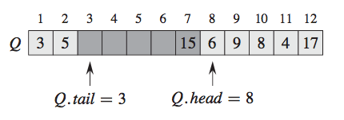
Queue Example
After:
DEQUEUE()
X

Slide 26
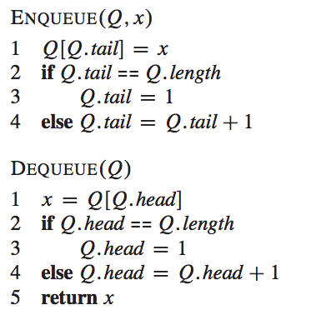
Queue Implementation
Each operation takes O(1) time.

Slide 27
Using Queues
As with stacks, must pull contents out of queue to view them. Assume we created our own Queue class.
// process (and destroy) an entire queue
while (!q.isEmpty()) {
do something with q.dequeue();
}
To examine each element exactly once.
int size = q.size();
for (int i = 0; i < size; i++) {
do something with q.dequeue();
(including possibly re-adding it to the queue)
}
Why do we need the size variable?

Slide 28
Mixing Stacks and Queues
We often mix Stacks and Queues to achieve certain effects.
Example: Reverse the order of the elements of a queue.
Queue<Integer> q = new Queue<Integer>();
q.enqueue(1);
q.enqueue(2);
q.enqueue(3); // [1, 2, 3]
Stack<Integer> s = new Stack<Integer>();
while (!q.isEmpty()) { // Q -> S
s.push(q.dequeue());
}
while (!s.isEmpty()) { // S -> Q
q.enqueue (s.pop());
}
System.out.println(q); // [3, 2, 1]

Slide 29
Java Stack Class
Stack<String> s = new Stack<String>();
s.push("a");
s.push("b");
s.push("c"); // bottom ["a", "b", "c"] top
System.out.println(s.pop()); // "c"
Stack has other methods that are off-limits (not efficient)
Stack<T>() | constructs a new stack with elements of type T
push(value) | places given value on top of stack
pop() | removes top value from stack and returns it; throws EmptyStackException if stack is empty
peek() | returns top value from stack without removing it; throws EmptyStackException if stack is empty
size() | returns number of elements in stack
isEmpty() | returns true if stack has no elements

Slide 30
Java Queue Interface
Queue<Integer> q = new LinkedList<Integer>();
q.add(42);
q.add(-3);
q.add(17); // front [42, -3, 17] back
System.out.println(q.remove()); // 42
IMPORTANT: When constructing a queue, you must use a new LinkedList object instead of a new Queue object.
Because Queue is an interface.
add(value) | places given value at back of queue
remove() | removes value from front of queue and returns it; throws a NoSuchElementException if queue is empty
peek() | returns front value from queue without removing it; returns null if queue is empty
size() | returns number of elements in queue
isEmpty() | returns true if queue has no elements

Slide 31
Exercises
Write a method stutter that accepts a queue of Integers as a parameter and replaces every element of the queue with two copies of that element.
[1, 2, 3] becomes [1, 1, 2, 2, 3, 3]
Write a method mirror that accepts a queue of Strings as a parameter and appends the queue's contents to itself in reverse order.
[a, b, c] becomes [a, b, c, c, b, a]

